Slide 1



Bank Analytics
Excel
powerbi
My sql

Slide 2

LIST OF KPI’S
Year wise loan amount Status
Grade and sub grade wise revol_bal
Total Payment for Verified Status Vs Total Payment for Non Verified Status
State wise and month wise loan status
Home ownership Vs last payment date status

Slide 3
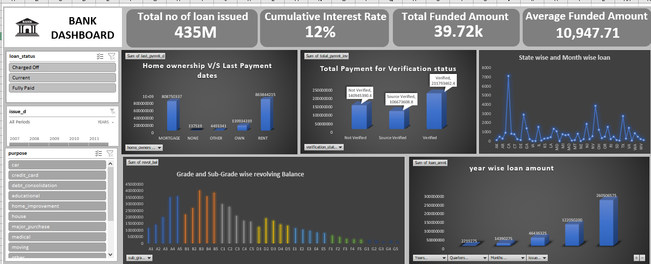
Excel Dashboard

Slide 4
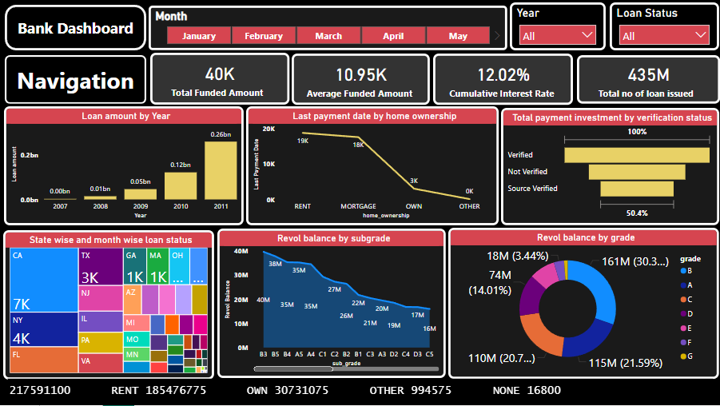
Power bi Dashboard

Slide 5
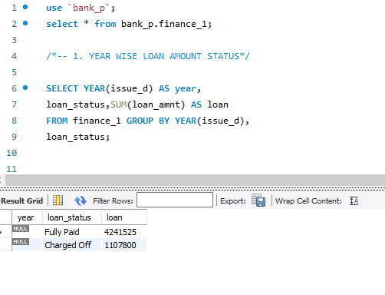
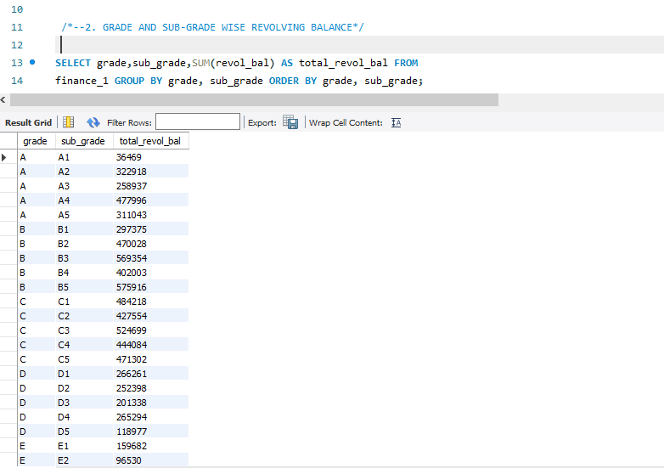
1.Kpi :- year wise loan amount status
My sql
2.Kpi :- Grade and subgrade wise revol balance

Slide 6
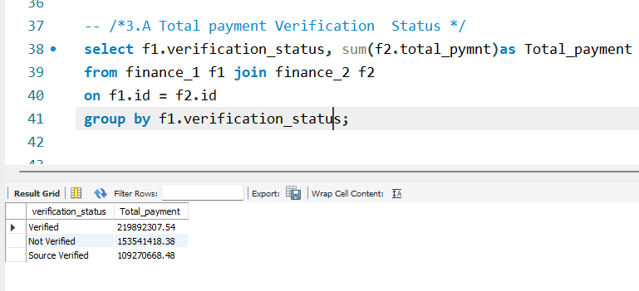
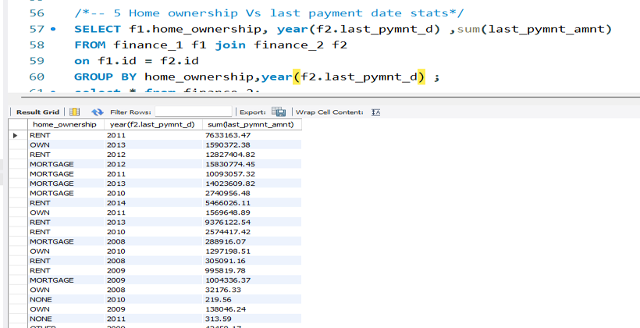
3.Kpi :- Total payment verification status
4.Kpi :- homeownership vs last payment date states

Slide 7
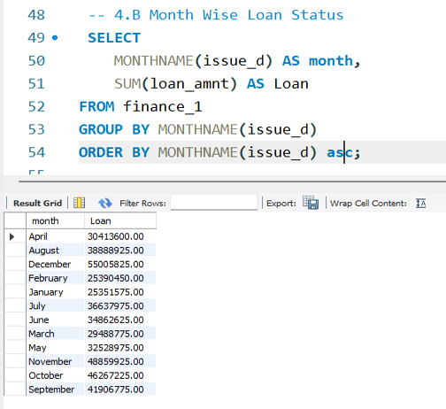
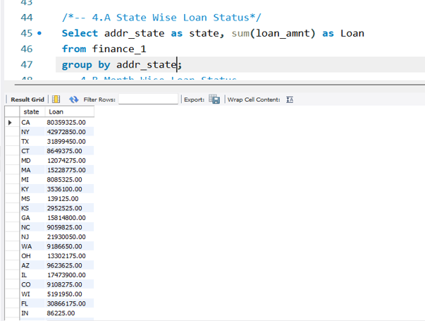
5.Kpi :- state wise and month wise loan status

Slide 8




PROJECT SUMMARY
Scope
Objective
Focused on Financial data from banking data.
Analyzed revenue trends, loan approval rates, and customer acquisition conversions.
To analyze customer and financial data
to enhance banking performance and
improve the business outcomes.
Methodology
Deliverables
Used Excel for data extraction and dashboards in Power BI, and Excel for insights.
Analyzed trends and created forecasts to support decisions.
Dashboards showing key metrics like Verfication status .
Insights to enhance financial performance and customer engagement.
Trends to guide future planning.

Slide 9


Thank You

